Slide 1
Calculus
Optimization Using Derivatives | Two Variable Functions

Slide 2
Outline
Extension from Single Variable Functions
Example
Second Derivative Test for Two Variable Functions

Slide 3
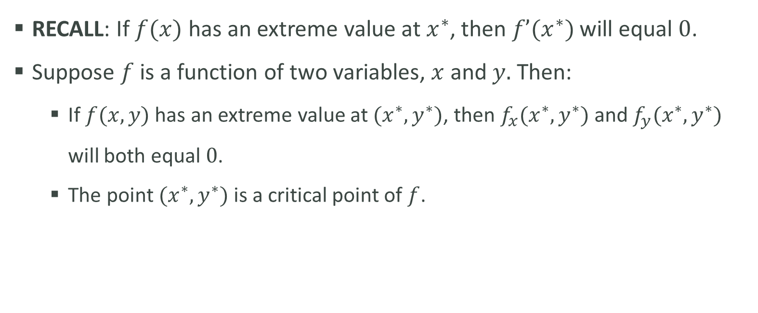
Definitions
RECALL: If $f(x)$ has an extreme value at $x^{∗}$, then $f’(x^{∗})$will equal $0$.
Suppose $f$ is a function of two variables, $x$ and $y.$ Then:
If $f(x,y)$ has an extreme value at $(x^{∗},y^{∗})$, then $f_{x}(x^{∗},y^{∗})$and $f_{y}(x^{∗},y^{∗})$ will both equal $0$.
The point $(x^{∗},y^{∗})$ is a critical point of $f$.

Slide 4
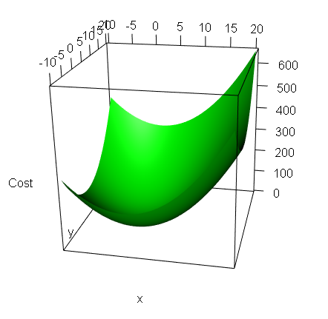
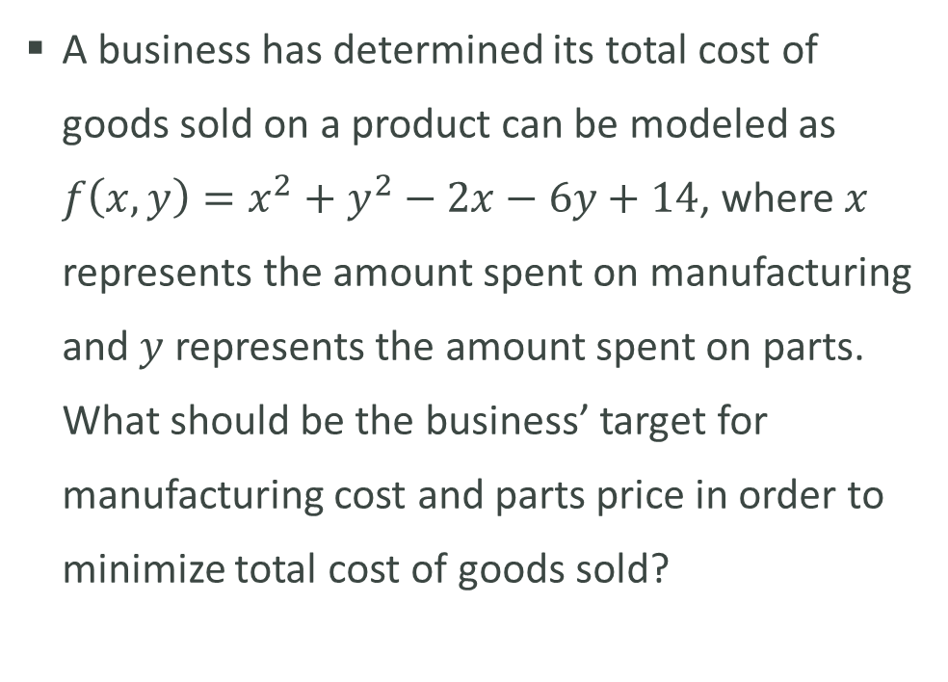
Example
A business has determined its total cost of goods sold on a product can be modeled as $f\left(x,y\right)=x^{2}+y^{2}−2x−6y+14$, where $x$ represents the amount spent on manufacturing and $y$ represents the amount spent on parts. What should be the business’ target for manufacturing cost and parts price in order to minimize total cost of goods sold?
Min Cost

Slide 5


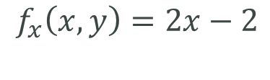

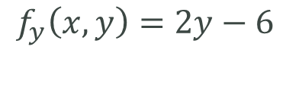



Example
How can we find where the min occurs? And exactly what the min value is?
By using the partial derivatives!
$$f\left(x,y\right)=x^{2}+y^{2}−2x−6y+14$$
$$f_{x}\left(x,y\right)=2x−2$$
$$f_{y}\left(x,y\right)=2y−6$$
$$2x−2=0$$
$$2y−6=0$$
$$x=1$$
$$y=3$$
This means $(1, 3)$is a critical point and thus 4 is the extreme (min) value.

Slide 6
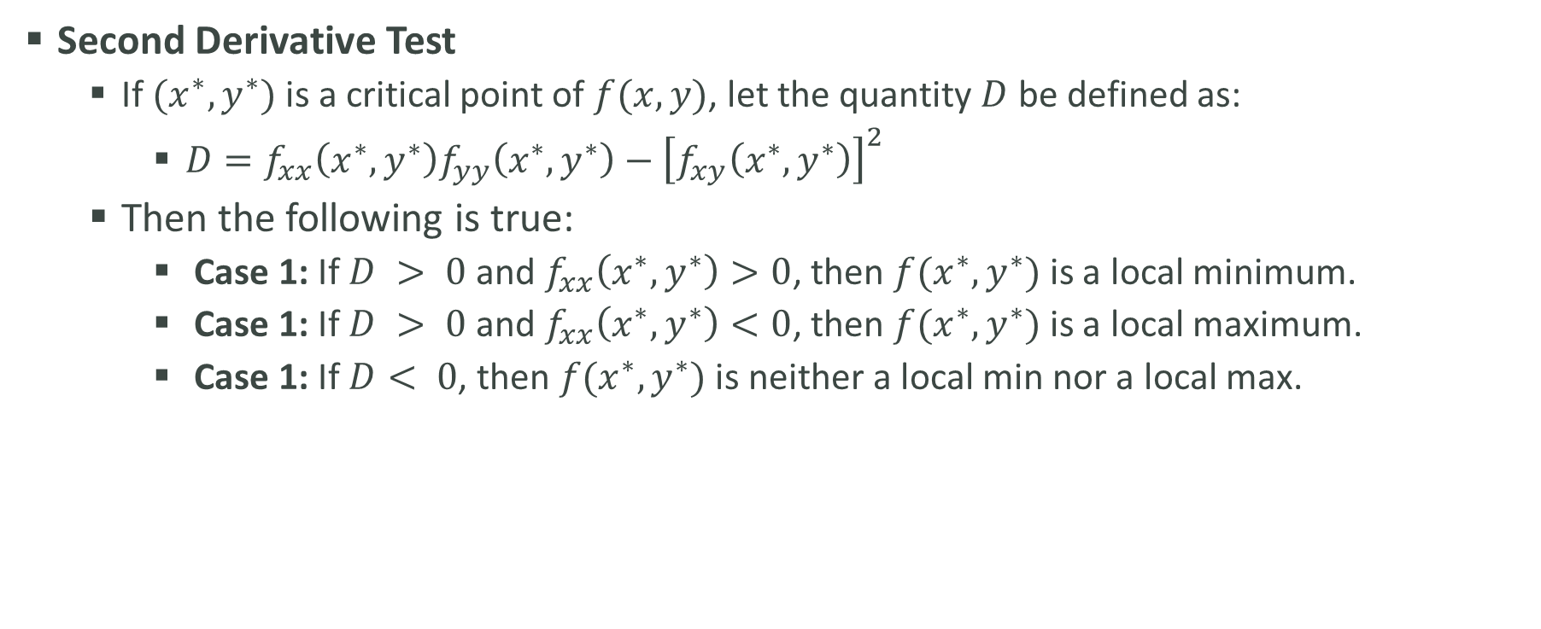
Second Derivative Test for Two Variable Functions
Second Derivative Test
If $(x^{∗},y^{∗})$ is a critical point of $f(x,y)$, let the quantity $D$ be defined as:
$D=f_{xx}\left(x^{∗},y^{∗}\right)f_{yy}\left(x^{∗},y^{∗}\right)−{\left[f_{xy}\left(x^{∗},y^{∗}\right)\right]}^{2}$
Then the following is true:
Case 1: If $D > 0$and $f_{xx}\left(x^{∗},y^{∗}\right)>0$, then $f(x^{∗},y^{∗})$ is a local minimum.
Case 1: If $D > 0$and $f_{xx}\left(x^{∗},y^{∗}\right)<0$, then $f(x^{∗},y^{∗})$ is a local maximum.
Case 1: If $D< 0$, then $f(x^{∗},y^{∗})$ is neither a local min nor a local max.

Slide 7






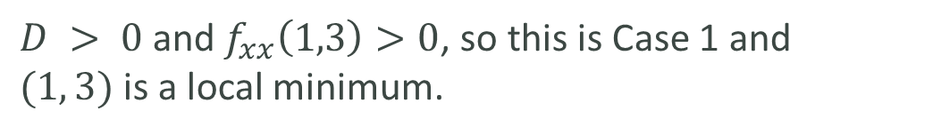
Second Derivative Test for Two Variable Functions
$$f_{x}=2x−2$$
$$f_{xx}=2 →f_{xx}\left(1,3\right)=2>0$$
$f_{y}=2x−6$
$$f_{yy}=2 →f_{yy}\left(1,3\right)=2>0$$
$$f_{xy}=0 →f_{xy}\left(1,3\right)=0$$
$$D=2∗2−0^{2}=4$$
$D > 0$and $f_{xx}\left(1,3\right)>0$, so this is Case 1 and $(1, 3)$is a local minimum.

